Slide 1
GITHUB PROJECT 2 - sTRING
MADE BY TEAM hEXARIA

Slide 2
Who are we?
Name | Role
Ivan Stankov Parashkevov - IX A ISParashkevov18@codingburgas.bg | Manager
Viktor Velizarov Velizarov - IX V VVVelizarov18@codingburgas.bg | Developer
Dimitur Emilianov Kaloyanov – IX G DEKaloyanov18@codingburgas.bg | Developer
Georgi Borislavov Kunev - IX B GBKunev18@codingburgas.bg | Developer

Slide 3
About the project
•The idea of our project is to create a program which will be used to sort, find and edit strings. The strings are saved in an array and you can add there is no limit to how much strings can be saved. When the program is started, the user is greeted with a main menu, from which he can go to other sub-menus.

Slide 4

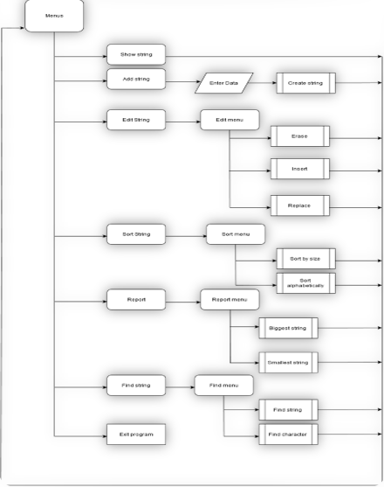
Logical Scheme of our program

Slide 5



Used technologies

Slide 6
Future improvements
•Add more reports to the reports menu
•Translate the menus in different languages
•Optimize the code so it loads fastera

